Slide 1
Analysis of Variance (ANOVA)
Randomized Block Design

Slide 2
First, let’s consider the assumptions
(Handouts: Assumptions Handout)
When using one-way analysis of variance, the process of looking up the resulting value of F in an F-distribution table, is reliable under the following assumptions:
The values in each of the groups (as a whole) follow the normal curve,
with possibly different population averages (though the null hypothesis is that all of the group averages are equal) and
equal population variances.

Slide 3
Normal Distribution
While ANOVA is fairly robust with respect to normality, a highly skewed distribution may have an impact on the validity of the inferences derived from ANOVA.
Check this with a histogram, stem-and-leaf display, or normal probability plot for the response, y, corresponding to each treatment.

Slide 4
Equal Population Variances
Book lists a few formal tests of homogeneity of variances available (p. 635, 636)
We can approximately check this by using as bootstrap estimates the sample standard deviations.
In practice, statisticians feel safe in using ANOVA if the largest sample SD is not larger than twice the smallest.

Slide 5
Randomized (Complete) Block Design
Sample Layout: Each horizontal row represents a block. There are 4 blocks (I-IV) and 4 treatments (A-D) in this example.
Block I A B C D
Block II D A B C
Block III B D C A
Block IV C A B D

Slide 6
Randomized Block Designs (Formulas: p. 575)
  Total SS = Treatment SS + Block SS + Error SS
  SS(Total) = SST + SSB + SSE
  In Minitab, we will use the Two-Way ANOVA option or the General Linear Model option.

Slide 7
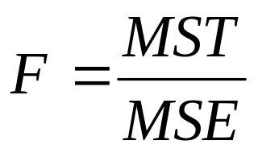
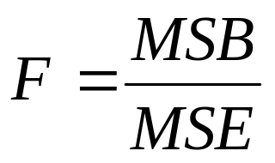
We will have two F values
For testing treatments:
For testing blocks:
These values are equivalent to the values in our nested F

Slide 8
Why test blocks?
If we want to determine if blocking was effective in removing extraneous sources of variation
  Is there evidence of difference among block means?
If there are no differences between block means, we lose information by blocking
  Blocking reduces the number of degrees of freedom associated with the estimated variance of the model
BUT it is okay to use the block design if you believe they may have an effect (p. 574)

